Slide 1
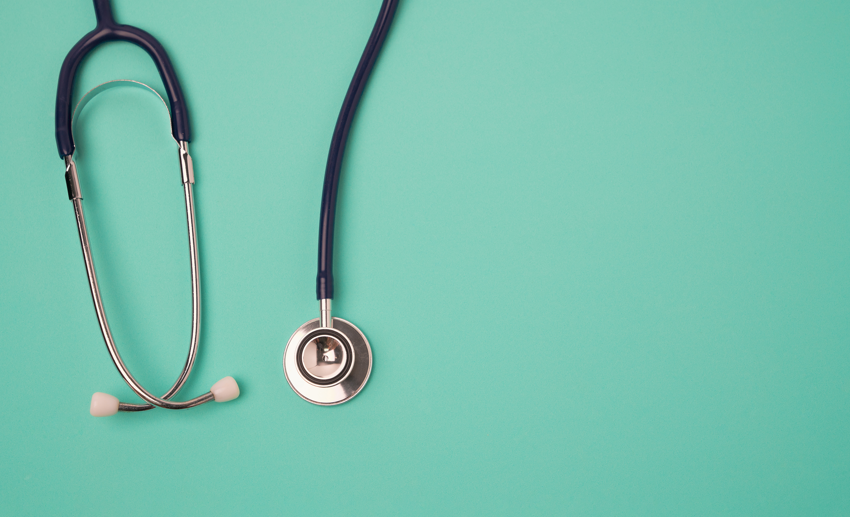
AI-Powered Disease Management System
BY: Jordyn Williams
Pooja Patel
Chinelo Aniekwu
Aryana Lawson
Stay ahead of chronic illness with our AI-powered platform that monitors your health in real time, detects early risks, and alerts you and your doctor instantly.
The platform collects real-time patient data from wearable monitors, electronic health records (EHRs), and manual entries. AI algorithms analyze this data to recognize patterns of risk and predict potential deteriorations in health. When anomalies are detected, the system warns patients as well as medical professionals, enabling instant action.

